Slide 1
Project A5MMS
Presented By:
Carlucenne Lopez
Jayson Naperi
Georgette Dela Cuesta
Earl Jerome Rocero

Slide 2
BUSINESS CASE
PURPOSE
PROJECT OVERVIEW
OBJECTIVES OF THE PROPOSED SYSTEM
REVIEW OF RELATED STUDY / SOFTWARE
ORGANIZATIONAL CHART
ROLES & RESPONSIBILITIES
GANTT CHART
COST & BENEFIT
SCOPE & LIMITATIONS
RISK MANAGEMENT
SUCCESS FACTORS

Slide 3
PURPOSE
Ease the application, employment and payroll transactions of the applicants, employees and clients.

Slide 4
PROJECT OVERVIEW
A5MMS (Corporation) operates manpower / janitorial services
Human Resource Management System
Application
Employment
Payroll

Slide 5
OBJECTIVES OF THE PROPOSED SYSTEM
Enhancement of application, employment and payroll transactions
HRMS Features:
HR Management Module
Applicant Module
Job Vacancy Module
Employment Module
Payroll Module

Slide 6
REVIEW OF RELATED STUDY / SOFTWARE
Global Data Systems
HRPayrollSystems.net

Slide 7
AGENCY ORGANIZATIONAL TABLE
NAME | POSITION
Jim T. Lopena | Chairman / Director
Paciano B. Lopena | Vice Chairman / President / Director
Josefina T. Lopena | Operations Manager / Director
Jennifer O. Gualberto | Corporate Secretary / Director
Arthur D. Tacbas | Director

Slide 8
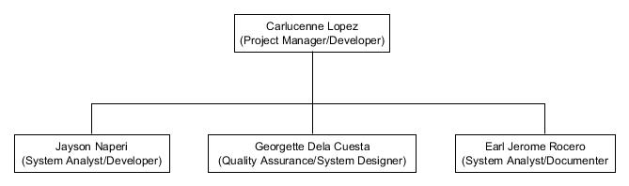
TEAM ORGANIZATIONAL CHART

Slide 9
ROLES & RESPONSIBILITIES
ROLES | RESPONSIBILITIES
Project Manager | Leads and Manages the Team Plans the project requirements Assigns the roles and responsibilities Monitors the project progress
System Analyst | Analyzes client’s business process Analyzes the project requirements Forecast project events Analyzes the system structure
System Developer | Analyzes the system requirements System Development
System Designer | Analyzes the system requirements System Designing
System Documenter | Project Documentation System Development Documentation System Design Documentation Test Documentation
Quality Assurance | Create Test Plan Leads and Conducts Testing

Slide 10
GANTT CHART
TASKS | DAYS
PLANNING
Identify team members and roles Client Meeting Identify the Business Process Identify the Business Requirements Build Project Plan | 1 day 1 day 1 day 1 day 3 days
ANALYSIS
Analyze Business Process Analyze Business Requirements Analyze Project Plan | 3 days 3 days 5 days

Slide 11
GANTT CHART
TASKS | DAYS
DESIGN
Design Planning Analyzing Design Draft of Screen Layout Prototype Designing Design Documentation | 1 day 1 day 2 days 7 days 2 days
DEVELOPMENT
Understanding the Project Plan Prototype Development Development Documentation | 1 day 7 days 2 days
TESTING
Create Test Plan Execute Testing Build Test Documentation | 1 day 1 day 2 days

Slide 12
Cost & Benefit
BENEFIT
TANGIBLE | INTANGIBLE
New Client Opportunity | Automated System
Increase of Applicants | Efficiency of information storage

Slide 13
Cost & Benefit
LABOR COST
POSITION | SALARY (4 Months)
Project Manager | 200,000 pesos
System Analyst | 160,000 pesos
System Developer | 148,000 pesos
System Designer | 132,000 pesos
System Documenter | 80,000 pesos
Quality Assurance | 120,000 pesos

Slide 14
Cost & Benefit
DEVELOPMENT COST
Hardware (PC) | 15,000 pesos
Software | 0.00
Training | 0.00
Office Space | 0.00

Slide 15
Cost & Benefit
OPERATIONAL COST
Hardware (PC) | 15,000 pesos
Software | 0.00
Domain /Hosting | 500 pesos / per month
Internet Charges | 999 pesos / per month
Training | 0.00

Slide 16
SCOPE & LIMITATIONS
System integrated to 3 parts:
HR Module
Payroll Module
Website

Slide 17
RISK MANAGEMENT
RISK | DEFINITION | RESPONSE
Information security disturbance | Risk of a security incident during the project. Chances of information going to be leaked | Integrate and study more on securing the system further.
Technological components are not fit for purpose | Risk of technological components are low quality. | Change of system requirement to the project would be necessary to adjust to the client’s resources.
Failure matching the organization’s culture | Risk of the system not being culturally fit in the business process of the client | As the project develops, it should be made sure that the system still follows the business process of the client.
Users have inaccurate expectations | Risk of the project where the clients may not understand the project that’s coming their way | Weekly project status reports to the client, setup meetings with the client pertaining to the development of the system.

Slide 18
SUCCESS FACTORS
Successfully view the available job details
Successfully inputted information and uploaded resume
Successfully login to the system
Successfully manages the HR Module appropriately
Successfully generates and computes payroll

Slide 19
DIAGRAMS
FUNCTIONAL DECOMPOSITION DIAGRAMS
CONTEXT DIAGRAM
DATA FLOW DIAGRAM (DIAGRAM 0)
ENTITY – RELATIONSHIP DIAGRAM
USE CASE DIAGRAM
USE CASE NARRATIVE
OBJECT DIAGRAM
SEQUENCE DIAGRAM
STATE TRANSITION DIAGRAM
ACTIVITY DIAGRAM

Slide 20
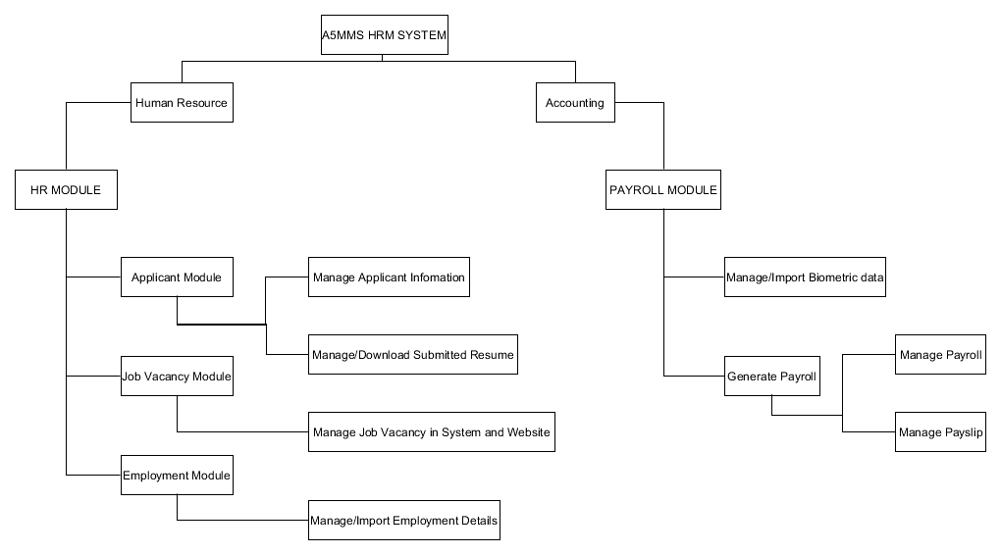
FUNCTIONAL DECOMPOSITION DIAGRAM

Slide 21
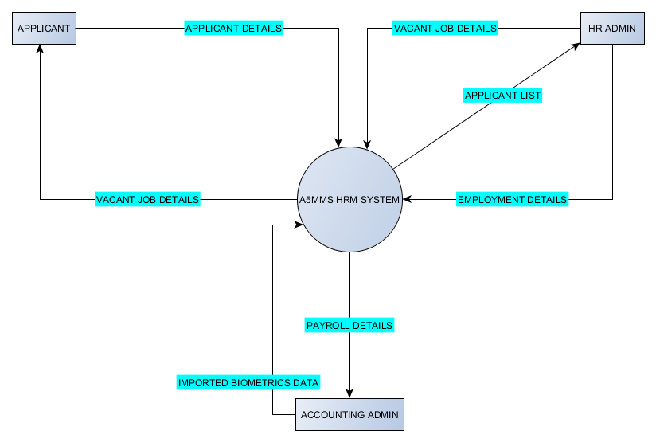
CONTEXT DIAGRAM

Slide 22
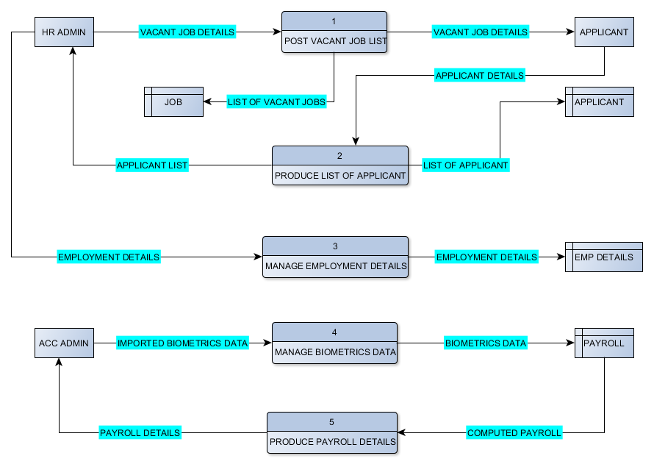
DATA FLOW DIAGRAM (DIAGRAM 0)

Slide 23
ENTITY – RELATIONSHIP DIAGRAM

Slide 24
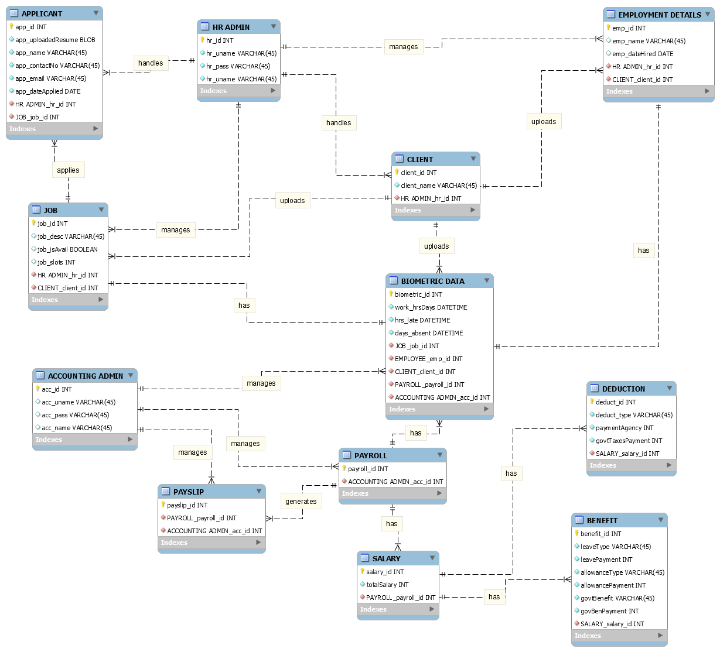

Slide 25
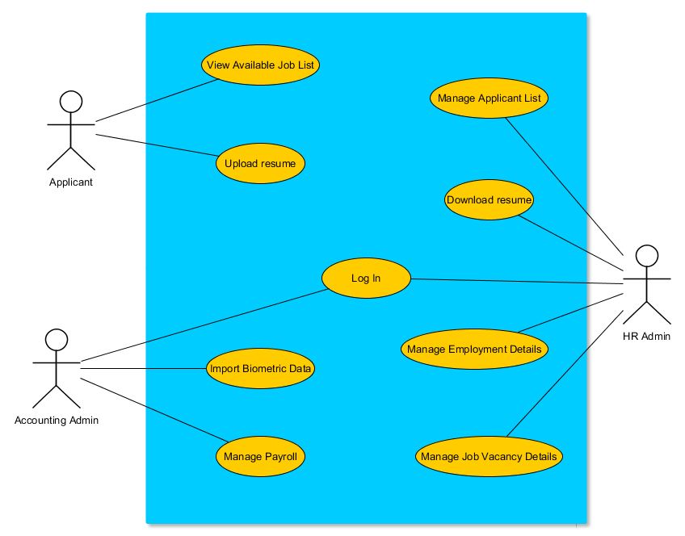
USE CASE DIAGRAM

Slide 26
USE CASE NARRATIVE
USE CASE NAME | View Available Job List
ACTOR | Applicant
DESCRIPTION | Describes the process in viewing the list of the job in the website
SUCCESSFUL COMPLETION | Applicant search for a job online Applicant found website’s list of jobs Applicant views job list in the system Applicant selects job
ALTERNATIVE | 3.1 Applicant search for another job online or wait for the availability of job list
PRE – CONDITION | Applicant searching for available job
POST – CONDITION | Found job
ASSUMPTIONS | Available job list posted online

Slide 27
USE CASE NARRATIVE
USE CASE NAME | Upload resume
ACTOR | Applicant
DESCRIPTION | Describes the process of submitting resume online
SUCCESSFUL COMPLETION | Applicant input personal information and uploads resume Applicant clicks upload button Applicant successfully submits resume
ALTERNATIVE | 3.1 Applicant submits resume through e-mail 3.2 Through e-mail the HR Admin manually input the applicant information in the system 3.3 Applicant will walk-in directly to the agency, HR Admin manually input information in the system
PRE – CONDITION | Selecting a job
POST – CONDITION | Successful submission of resume
ASSUMPTIONS | Applicant input personal information with uploaded resume in the website

Slide 28
USE CASE NARRATIVE
USE CASE NAME | Log - In
ACTOR | HR Admin / Accounting Admin
DESCRIPTION | Describes the process of logging – in to the system
SUCCESSFUL COMPLETION | Admin opens the system Admin log in to the system
ALTERNATIVE | Create new admin account
PRE – CONDITION | Opens the system
POST – CONDITION | Access the system
ASSUMPTIONS | Admin has already an account

Slide 29
USE CASE NARRATIVE
USE CASE NAME | Manage Applicant List
ACTOR | HR Admin
DESCRIPTION | Describes the process in managing the applicant list
SUCCESSFUL COMPLETION | HR Admin selects applicant module HR Admin views list of applicant HR Admin manages list of applicant
ALTERNATIVE | Applicant will contact/walk – in directly to the agency for the applicant information submission Manual management of applicant details
PRE – CONDITION | HR Admin selects applicant module
POST – CONDITION | HR Admin update applicant details
ASSUMPTIONS | Applicant submitted resume

Slide 30
USE CASE NARRATIVE
USE CASE NAME | Downloads resume
ACTOR | HR Admin
DESCRIPTION | Describes the process in downloading the list of resume
SUCCESSFUL COMPLETION | HR Admin opens applicant module HR Admin opens applicant list HR downloads resume
ALTERNATIVE | Remain the resume store in the database
PRE – CONDITION | Applicant uploads resume
POST – CONDITION | Hard copies of resume
ASSUMPTIONS | Applicant submitted resume

Slide 31
USE CASE NARRATIVE
USE CASE NAME | Manages employment details
ACTOR | HR Admin
DESCRIPTION | Describes the process in managing the employment details
SUCCESSFUL COMPLETION | HR Admin imports the employment details sent by the client through e-mail HR Admin selects employment module HR Admin manages the employment details
ALTERNATIVE | 1.1 Contact/Personally meet the client regarding on the employment details submission 1.2 HR Admin manually input the employment details in the system
PRE – CONDITION | Client sends employment details to the agency through e-mail
POST – CONDITION | HR Admin update employment details
ASSUMPTIONS | HR Admin received the employment details from client

Slide 32
USE CASE NARRATIVE
USE CASE NAME | Manages job vacancy details
ACTOR | HR Admin
DESCRIPTION | Describes the process in managing the job vacancy details
SUCCESSFUL COMPLETION | HR Admin imports the job vacancy details sent by the client through e-mail HR Admin selects job vacancy module HR Admin manages the job vacancy details
ALTERNATIVE | 1.1 Contact/Personally meet the client regarding on the job vacancy details submission 1.2 HR Admin manually input the job vacancy details in the system
PRE – CONDITION | Client sends job vacancy details to the agency through e-mail
POST – CONDITION | HR Admin update available job
ASSUMPTIONS | HR Admin received the job vacancy details from client

Slide 33
USE CASE NARRATIVE
USE CASE NAME | Import biometric data
ACTOR | Accounting Admin
DESCRIPTION | Describes the process in importing biometric data
SUCCESSFUL COMPLETION | Accounting Admin selects payroll module Accounting Admin imports biometrics data sent by the client through e-mail
ALTERNATIVE | 1.1 Contact/Personally meet the client regarding on the biometric data submission 1.2 HR Admin manually input the biometric data in the system
PRE – CONDITION | Client sends biometric data to the agency through e-mail
POST – CONDITION | System prompts feedback for successfully import biometric data
ASSUMPTIONS | Accounting Admin received the biometric data from the client

Slide 34
USE CASE NARRATIVE
USE CASE NAME | Manages Payroll
ACTOR | Accounting Admin
DESCRIPTION | Describes the process of managing payroll
SUCCESSFUL COMPLETION | Accounting Admin selects payroll module Accounting Admin computes and manages payroll and pay slip
ALTERNATIVE | 2.1 Manual management and computation of the payroll and pay slip
PRE – CONDITION | Accounting admin imported biometric data
POST – CONDITION | Auto-generated payroll report and pay slip Softcopy / printed pay slip received by the employee through e-mail / personal
ASSUMPTIONS | Accounting Admin imported the biometric data

Slide 35
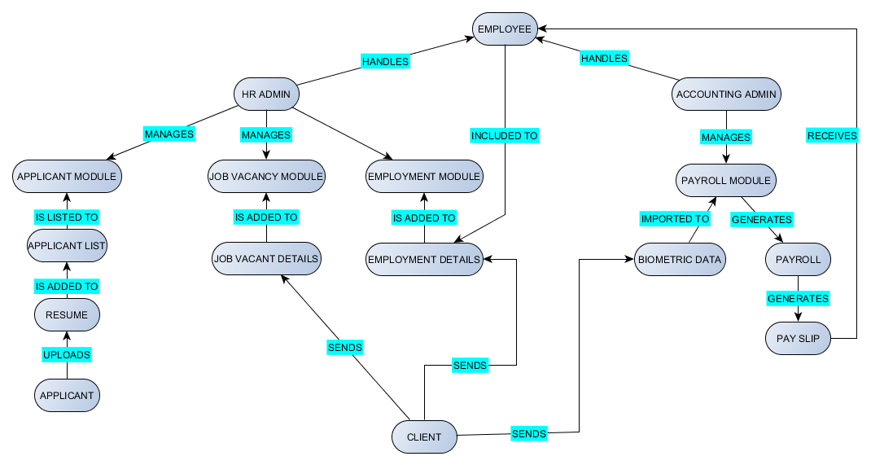
OBJECT DIAGRAM

Slide 36
SEQUENCE DIAGRAM (View Available Job List / Upload Resume)

Slide 37
SEQUENCE DIAGRAM (HR Log In / Manage Applicant List / Download resume)

Slide 38
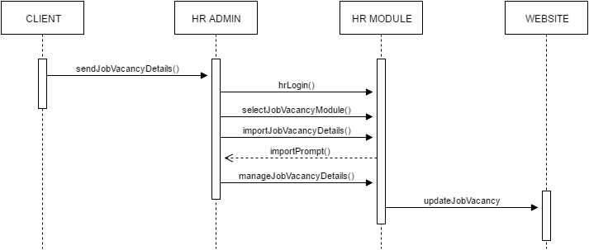
SEQUENCE DIAGRAM (HR Log In / Manage Job Vacant Details)

Slide 39
SEQUENCE DIAGRAM (HR Log In / Manage Employment Details)

Slide 40
SEQUENCE DIAGRAM (Accounting Log In / Import Biometric Data / Manage Payroll)

Slide 41

STATE TRANSITION DIAGRAM (Admin Accounts)

Slide 42
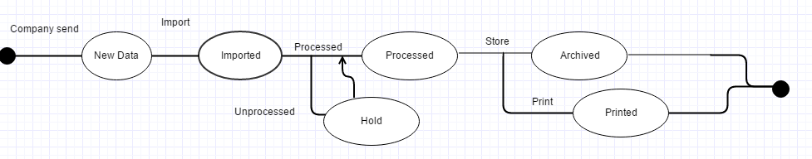
STATE TRANSITION DIAGRAM (Biometrics)

Slide 43
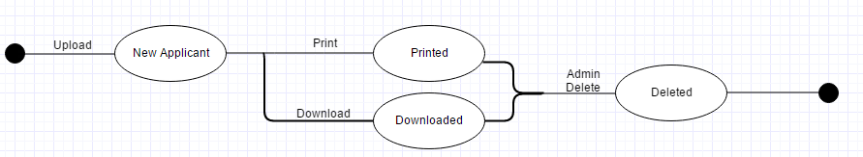
STATE TRANSITION DIAGRAM (Resume)

Slide 44
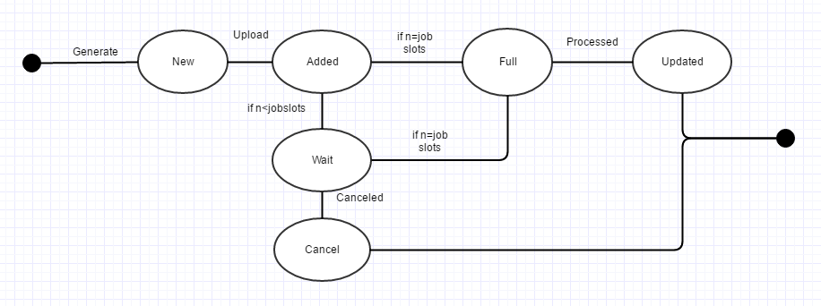
STATE TRANSITION DIAGRAM (Applicant List)

Slide 45
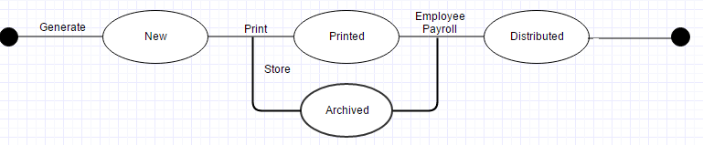
STATE TRANSITION DIAGRAM (Pay Slip)

Slide 46
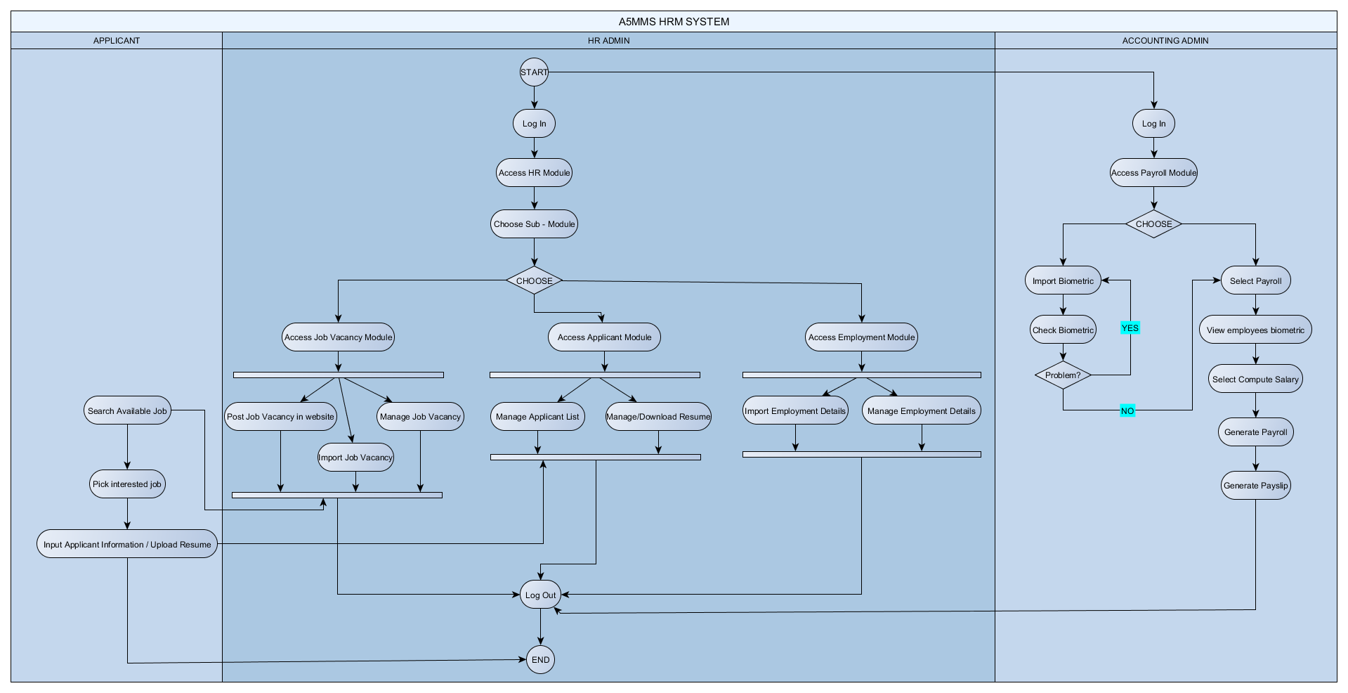
ACTIVITY DIAGRAM

Slide 47
SOFTWARE REQUIREMENTS SPECIFICATION CHECKLIST
OUTPUT | ASSIGNED TO | YES | NO | REMARKS
The website shall display available job posted by the HR Admin. The website shall prompt successful uploaded resume and input information by the applicant. The system must prompt successful logging in of the HR Admin and Accounting Admin. Applicant Module (under HR Module), must display information of applicants with their submitted resume. Employment Module (under HR Module), must prompt successful import of employment details by the HR Admin. Employment Module (under HR Module), must display information of employees with their employment details such as their job, date hired, and other. Job Vacancy Module (under HR Module) must prompt successful import of vacant job details by the HR Admin. Job Vacancy Module (under HR Module) must display available job details to be posted on the website. Payroll Module must prompt successful import of biometrics by the Accounting Admin. Payroll Module must display payroll details and reports Pay Slip Module must display and prints pay slip details of each employee. | CARLUCENNE LOPEZ CARLUCENNE LOPEZ CARLUCENNE LOPEZ CARLUCENNE LOPEZ CARLUCENNE LOPEZ CARLUCENNE LOPEZ CARLUCENNE LOPEZ CARLUCENNE LOPEZ CARLUCENNE LOPEZ CARLUCENNE LOPEZ CARLUCENNE LOPEZ

Slide 48
SOFTWARE REQUIREMENTS SPECIFICATION CHECKLIST
INPUT | ASSIGNED TO | YES | NO | REMARKS
The applicant shall input personal information and upload resume. The HR Admin and Accounting Admin must enter their accounts to log in to the system and also input another admin accounts. The HR Admin must input / import employment details and job vacancy details to the system sent by the client. The Accounting Admin must input / import biometrics to the system sent by the client. | JAYSON NAPERI JAYSON NAPERI JAYSON NAPERI JAYSON NAPERI

Slide 49
SOFTWARE REQUIREMENTS SPECIFICATION CHECKLIST
PROCESS | ASSIGNED TO | YES | NO | REMARKS
The applicant will search for a job in the website, then upload resume and some personal information. The HR Admin manages the applicant details and resume, then the system will produce list of it everyday and manage by the HR Admin. The HR Admin imports / inputs job vacancy details sent by the client and manage the details of vacant job to be posted on the website. The HR Admin imports / inputs employment details sent by the client and manage the details. The Accounting Admin imports / inputs biometrics sent by the client and manage it in the payroll module. The Accounting Admin selects the Compute payroll then the system will auto – compute the payroll. The Accounting Admin selects the generate and manage payroll report and pay slip. | EARL JEROME ROCERO EARL JEROME ROCERO EARL JEROME ROCERO EARL JEROME ROCERO EARL JEROME ROCERO EARL JEROME ROCERO EARL JEROME ROCERO

Slide 50
SOFTWARE REQUIREMENTS SPECIFICATION CHECKLIST
PERFORMANCE | ASSIGNED TO | YES | NO | REMARKS
The system must store millions of data. The website must not exceed to display 100 of available jobs. The uploading / sending process of applicant information and resume must not exceed 5 seconds. The importing of employment, job vacancy, and biometrics to the system must not exceed 10 seconds. The computation of payroll must be done within 20 – 30 seconds. Generating process of payroll report and pay slip must not exceed 15 – 20 seconds. | Georgette Dela Cuesta Georgette Dela Cuesta Georgette Dela Cuesta Georgette Dela Cuesta Georgette Dela Cuesta Georgette Dela Cuesta

Slide 51
SOFTWARE REQUIREMENTS SPECIFICATION CHECKLIST
CONTROL | ASSIGNED TO | YES | NO | REMARKS
The system must provide logon security for both HR Admin and Accounting Admin. The HR Admin can import/input, edit, archive, filter / sort the employment, applicant and vacant job details. The Accounting Admin can import / input, edit, archive, filter / sort the biometrics, payroll reports, and pay slips. | CARLUCENNE LOPEZ CARLUCENNE LOPEZ CARLUCENNE LOPEZ

